Slide 1


INSTITUTE - UIE
DEPARTMENT- ACADEMIC UNIT-2
Bachelor of Engineering (Computer Science & Engineering)
Subject Name: Introduction to Problem Solving
Code:22CSH-101
CHAPTER NAME -FUNCTION

Slide 2

Course objectives
OBJECTIVES
The course aims to provide exposure to problem solving with programming
The course aims to raise the programming skills of students via logic building capability
With the knowledge of C language students would be able to model real world problems

Slide 3



Course Outcomes
CO Number | Course Outcome
CO1 | Remember the concepts related to fundamentals of C language, draw flowcharts and write algorithm/pseudocode.
CO2 | Understand the way of execution and debug programs in C language.
CO3 | Apply various constructs, loops, functions to solve mathematical and scientific problem.
CO4 | Analyze the dynamic behavior of memory by the use of pointers.
CO5 | Design and develop modular programs for real world problems using control structure and selection structure.

Slide 4
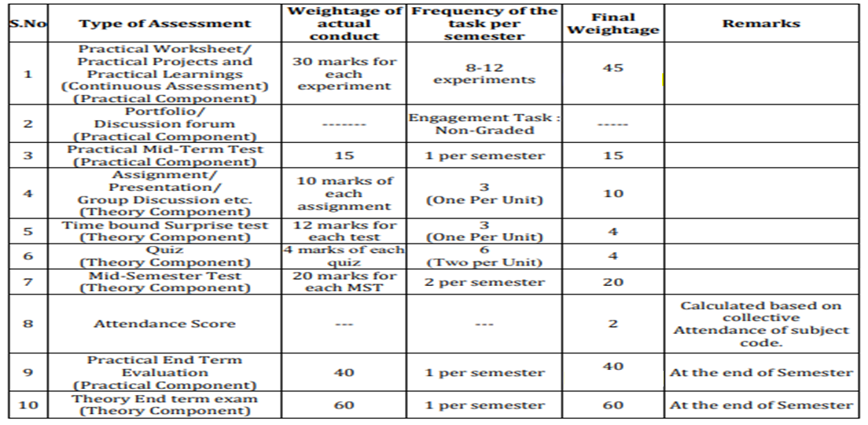
Scheme of Evaluation

Slide 5
User defined Function and its types
CONTENT
parameters types, parameter passing
calling a function
Examples

Slide 6
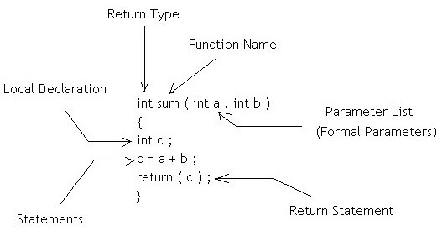
DEFINITION: A large C program is divided into basic building blocks called C function. C function contains set of instructions enclosed by “{ }” which performs specific operation in a C program. Actually, Collection of these functions creates a C program.
Components of a Function:
User Defined Function

Slide 7
Return-type: This specifies the data type of the value being returned by the function. A function may or may not return a value. If the function does not return a value, then the return type is void. In this case, the return value is an integer value c, which means the return type would be int.
Parameter list: The list of formal parameters being passed onto the function. In this case, there are two parameters of type int passed to the function.
Local variables or local declarations: The variables that are declared inside the function are called local variables. The scope of these variables lies within the function and they are not accessible outside the function.
Function body: Comprised of everything inside the curly brackets { and } following the return type, function name and the parameter list.
User Defined
Function

Slide 8
Function name: The name of the function can be anything that you want. The standard is to make it something related to what it's supposed to do. The naming convention follows the same rule as that of variable naming convention in C.
Function declaration: Tells the compiler all about the function. These include the function's name, the return type, and the number and types of parameters. The body of the function having the function definition can be defined somewhere else.
A function declaration has the following parts:
return_type function_name( parameter list );
User Defined
Function
The example here can be declared as follows:
int sum(int num1, int num2);
Or
return_type function_name(datatypes)
int sum(int,int);

Slide 9
Types of user defined functions:
There can be 4 different types of user-defined functions, they are:
1. Function with no arguments and no return value.
2. Function with no arguments and a return value
3. Function with arguments and no return value
4. Function with arguments and a return value
Types of User Defined
Function

Slide 10
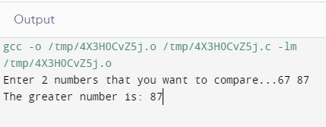
Such functions can either be used to display information or they are completely dependent on user inputs.
Example: It takes 2 numbers as input from user, and display which is the greater number.
#include<stdio.h>
void greatNum(); // function declarationint
main()
{
greatNum(); // function call
return 0;
}
void greatNum() // function definition
{
int i, j;
printf("Enter 2 numbers that you want to compare...");
scanf("%d%d", &i, &j);
if(i > j)
{
printf("The greater number is: %d", i);
}
else
{
printf("The greater number is: %d", j);
}
}
Function with no arguments and no return value

Slide 11
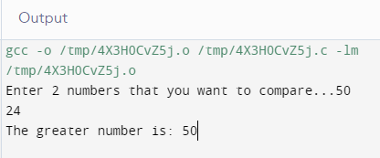
We have modified the above example to make the function greatNum() return the number which is greater amongst the 2 input numbers.
#include<stdio.h>
int greatNum(); // function declaration
int main()
{
int result;
result = greatNum(); // function call
printf("The greater number is: %d", result);
return 0;}int greatNum() // function definition
{
int i, j, greaterNum;
printf("Enter 2 numbers that you want to compare...");
scanf("%d%d", &i, &j); if(i > j)
{
greaterNum = i;
}
else
{
greaterNum = j;
} // returning the result
return greaterNum;
}
Function with no arguments and a return value

Slide 12
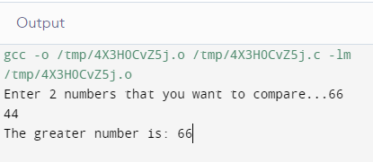
We are using the same function as example again and again, to demonstrate that to solve a problem there can be many different ways.
This time, we have modified the above example to make the function greatNum() take two int values as arguments, but it will not be returning anything.
#include<stdio.h>
void greatNum(int a, int b); // function declarationint main()
{
int i, j;
printf("Enter 2 numbers that you want to compare...");
scanf("%d%d", &i, &j);
greatNum(i, j); // function call
return 0;
}
void greatNum(int x, int y) // function definition
{
if(x > y)
{
printf("The greater number is: %d", x);
}
else
{
printf("The greater number is: %d", y);
}
Function with arguments and no return value

Slide 13
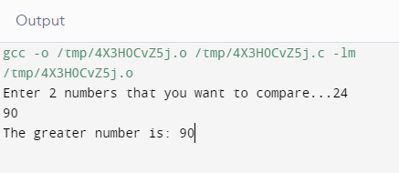
It makes the function completely independent of inputs and outputs, and only the logic is defined inside the function body.
#include<stdio.h>
int greatNum(int a, int b); // function declaration
int main()
{
int i, j, result;
printf("Enter 2 numbers that you want to compare...");
scanf("%d%d", &i, &j);
result = greatNum(i, j); // function call
printf("The greater number is: %d", result);
return 0;
}
int greatNum(int x, int y) // function definition
{
if(x > y)
{
return x;
}
else { return y; }
}
Function with arguments and a return value

Slide 14
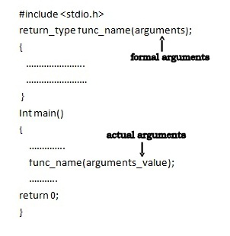
Parameter Passing Techniques in C: There are different ways in which parameter data can be passed into and out of methods and functions.
Formal Parameter : A variable and its type as they appear in the prototype of the function or method.
Actual Parameter : The variable or expression corresponding to a formal parameter that appears in the function or method call in the calling environment.
Passing Parameters

Slide 15
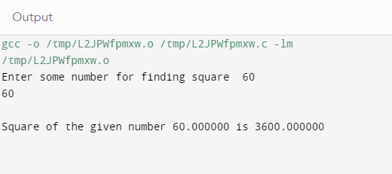
EXAMPLE: Program to find square of a number
#include<stdio.h>
float square ( float x ); //function declaration
int main( )
{
float m, n ;
printf ( "\nEnter some number for finding square \n");
scanf ( "%f", &m ) ;
n = square ( m ) ; // function call
printf ( "\nSquare of the given number %f is %f”,m,n );
}
float square ( float x ) // function definition
{
float p ;
p = x * x ;
return ( p ) ;
}
Example of parameter passing

Slide 16
There are two ways that a C function can be called from a program. Functions can be invoked in two ways:
Call by Value
Call by Reference.
These two ways are generally differentiated by the type of values passed to them as parameters.
Call By Value: In this parameter passing method, values of actual parameters are copied to function’s formal parameters and the two types of parameters are stored in different memory locations. So any changes made inside functions are not reflected in actual parameters of caller.
Call by Reference: Both the actual and formal parameters refer to same locations, so any changes made inside the function are actually reflected in actual parameters of caller.
HOW TO CALL
C FUNCTIONS IN A PROGRAM?

Slide 17
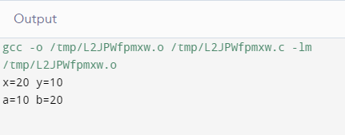
Example: Swap two numbers using
Call by Value
#include <stdio.h>
void swap(int x, int y);
int main()
{
int a = 2, b = 3;
swap(a, b);
printf("a=%d b=%d\n", a, b);
return 0;
}
void swap(int x, int y)
{
int t;
t = x;
x = y;
y = t;
printf("x=%d y=%d\n", x, y);
}
Call by Value
Example
Thus actual values of a and b remain unchanged even after exchanging the values of x and y. In call by values we cannot alter the values of actual variables through function calls

Slide 18
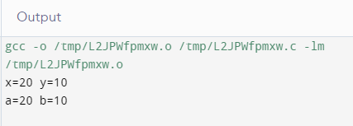
Example: Swap two numbers using Call by Reference #include <stdio.h> void swap(int*, int*); int main() { int a =2, b = 3; swap(&a, &b); printf("a=%d b=%d\n", a, b); return 0; } void swap(int* c, int* d) { int t; t = *x; *x = *y; *y = t; printf("x=%d y=%d\n", *x, *y); }
Call by Reference
Example
Thus actual values of a and b get changed after exchanging values of x and y. In call by reference we can alter the values of variables through function calls.

Slide 19
SUMMARY…..
We covered User defined function
Parameters passing
Call by value & Call by reference

Slide 20
FREQUENTLY ASKED QUESTIONS
PROGRAMS
Q1 Write a program in C to check a given number is even or odd using the function.
2. Write a program in C to check whether a number is a prime number or not using the function.
3. Write a program in C to check armstrong numbers using the function.
4. Write a program in C to find the sum of the series 1!/1+2!/2+3!/3+4!/4+5!/5 using the function.
5. Write a program to display fibonacci series upto user required number using function.

Slide 21
1. Choose correct statement about Functions in C Language.
A) A Function is a group of c statements which can be reused any number of times.
B) Every Function has a return type.
C) Every Function may no may not return a value.
D) All the above.
2 What is the output of C Program with functions.? void show(); int main() { show(); printf("ARGENTINA "); return 0; } void show() { printf("AFRICA "); }
A) ARGENTINA AFRICA
B) AFRICA ARGENTINA
C) ARGENTINA
D) Compiler error
3) How many values can a C Function return at a time.?
A) Only One Value
B) Maximum of two values
C) Maximum of three values
D) Maximum of 8 values
UTILISE YOUR KNOWLEDGE TO ANSWER
Let us see how much you have learned from the lecture and how effectively you can apply your knowledge…!!

Slide 22
4 What are types of Functions in C Language.?
A) Library Functions
B) User Defined Functions
C) Both Library and User Defined
D) None of the above
5. Which of the following statement is true about a function with an argument?
A. No value is pass to the function during function call.
B. function with an argument must not have return type
C. function with an argument is declared and define with parameter list
D. none of the above
UTILISE YOUR KNOWLEDGE TO ANSWER
Let us see how much you have learned from the lecture and how effectively you can apply your knowledge…!!

Slide 23

Discussion
Forum
Write a program for ATM machine using function.

Slide 24
Book Reference:
https://en.wikibooks.org/wiki/C_Programming
Vedio Lecture:
https://nptel.ac.in/courses/106/106/106106127/
https://www.youtube.com/watch?v=4-xX9vmPDsc
https://www.youtube.com/watch?v=Dt9q3qiaqiA
Websites: https://www.tutorialspoint.com/cprogramming/c_functions.htm
https://www.cs.utah.edu/~germain/PPS/Topics/C_Language/c_functions.html
https://beginnersbook.com/2014/01/c-function-call-by-value-example/
REFERENCES
Book Reference
Video Lectures
Websites

Slide 25
THANK YOU….

